Slide 1
Introduction to Ecology

Slide 2
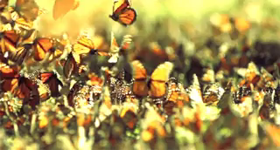
By the end of the lesson, you should be able to:
1. | Define the term ecology.
2. | Define the keywords habitat, environment and ecosystem.

Slide 3
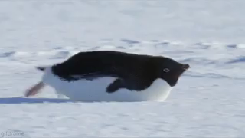
Ecology is the study of the relationships between living things and their physical environments.
The physical environment includes things like climate, water, and soil.

Slide 4
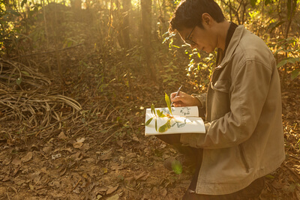
Ecologists are the scientists who study ecology.
They are curious and like to learn about living things by observing them, and recording what they find.

Slide 5
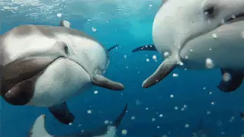
They might study the behaviour of a single species to see how it interacts with other organisms and the environment.
Other types of ecologists might study many different species that either depend on each other, or compete with each other for food and space.
There are many fields of ecology with lots of things still to be discovered. That's what makes it so exciting!

Slide 6
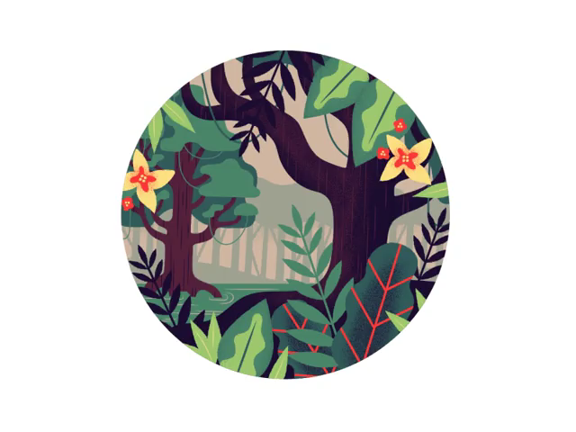
You will also learn about the flow of energy and matter through ecosystems, and the sustainability of these processes.

Slide 7
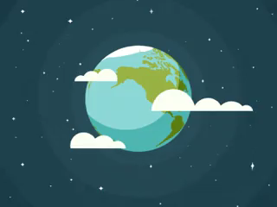
Think about the terms habitat, environment and ecosystem. Do you know what they mean?

Slide 8
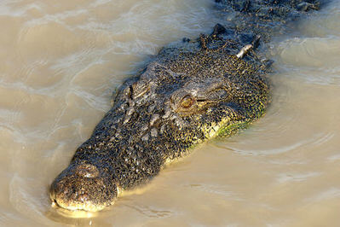
A habitat is the place where an organism lives.
A habitat includes both biotic factors, like other organisms, and abiotic factors, like water availability.
For example, the habitat of saltwater crocodiles include warm marine, brackish and freshwater environments in Northern Australia.

Slide 9
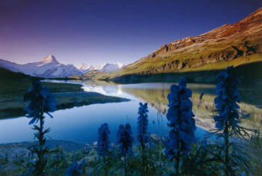
An ecosystem includes all of the interactions between living and non-living factors in an area.
An environment is the set of living and non-living factors in a given area.

Slide 10
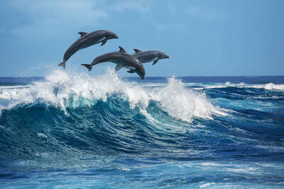
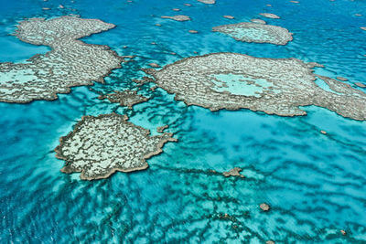
The Pacific Ocean is an example of an environment.
The Great Barrier Reef is an example of an ecosystem. The ecosystem includes the Pacific Ocean, the organisms that occupy it and how they interact within it.

